Slide 1
Using Social Media to Predict Stock Price
An analysis done by DN & Drexel’s Big Data
Authors: Nelson Blickman and Dhruvit Naik

Slide 2

Our Inspiration
Inspired by the Reddit GameStop event. Social Media posts on Reddit led to a huge surge in stock price of GameStop, a company that hedge fund managers had been sure was a dying company.
Social Media and the ease at which information is spread is a new dynamic that impacts and has influence over the stock market in todays world. Trying to understand how social media language will affect a stocks price has become a relatively common analysis.

Slide 3
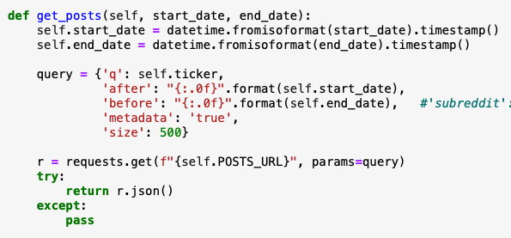
Data Acquisition: Reddit API
Calling Reddit’s API to retrieve posts of Reddit users within a certain timeframe was efficient and free. This PushShift.io link was used for efficiency: https://redditsearch.io
Acquired Posts and used the Post ID to acquire comments from January–April of 2021

Slide 4
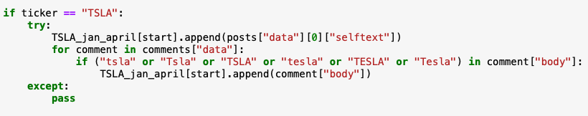
Data Acquisition: Reddit API
Filtered the acquired posts and comments that had the company name or ticker in the post. This reduced the noise and irrelevant data.
Our current companies for analysis include Tesla, General Electric, Advanced Micro Devices, and Nvidia, due to the high number of Reddit posts associated with these companies.

Slide 5

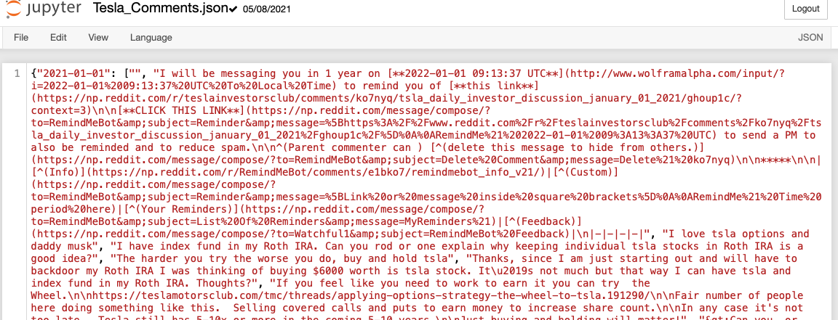
Data Acquisition: Reddit API
Code
Writing all of the posts and comments for each company into a Json Object was clean, and allowed for future EDA analysis on the data.
The features of this data will include whether a Post or Comment is of Positive or Negative Sentiment
Json Object

Slide 6
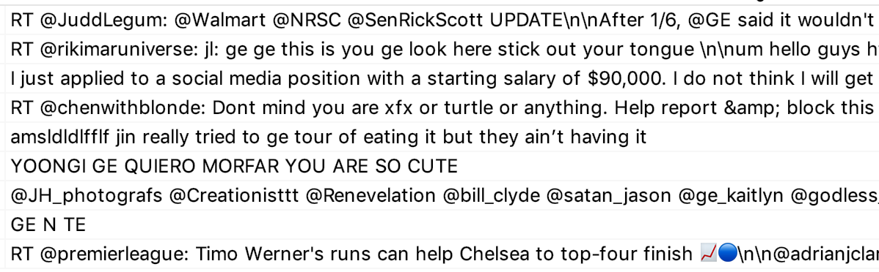
Data Acquisition: Twitter API
Using the basic Twitter API we searched for Tweets using a combination of ticker symbol, company name, and hashtags
Challenges:
We found that the Tweets we received were not always relevant to the company or their stock
Limited to only the past 7 days

Slide 7
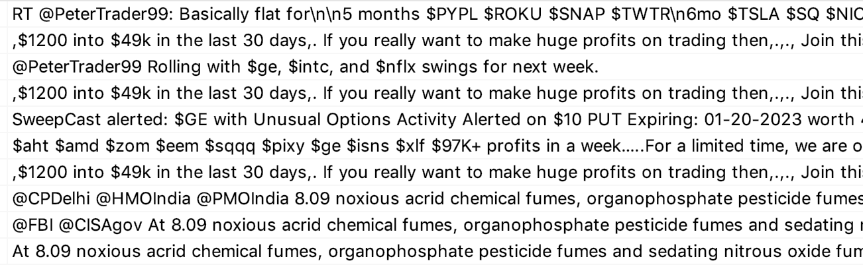
Data Acquisition: Twitter API
Solution:
Recently got approved to use Twitter’s Academic Research API
Allows us to use Cash Tags ($GE)
Enables us to have full archival search for tweets at any time period

Slide 8
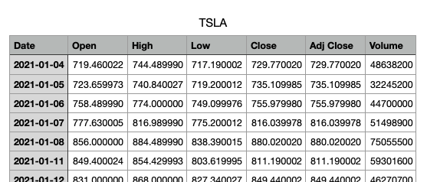
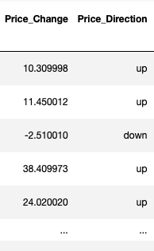
Data Acquisition: Yahoo Finance
Yahoo Finance supplies a clean CSV data file with our requested company and timeframe. The features listed below were included in this data.
Other Features were created in Python such as the Change in Price of stock on a particular day

Slide 9
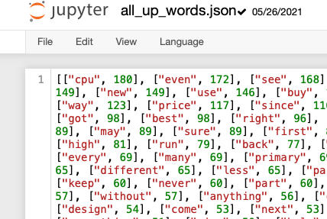
Cleaning EDA phase 1
With Finance and Social Media Data acquired, EDA is begun by creating Counter structures of each word in the social media posts. One structure includes the word counts on days the stock price went up, and one structure is for all the days the stock price went down. This was done for each of the 4 companies post/comments json object, and then compiled into one place. The final two word count structures were also written to json objects (see up words in image to the right).
The table below lists the compiled variable features, and their types:

Slide 10
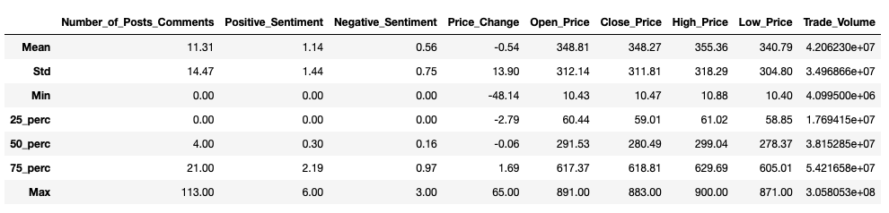
Descriptive Statistics

Slide 11
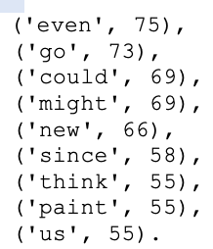
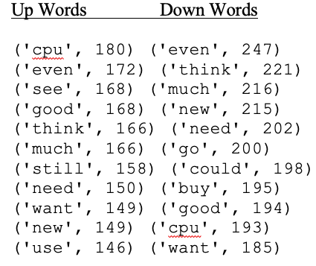
Plotting Eda phase 2
Fig A
EDA analysis involved the created word count structures.
The word “even” had the highest discrepancy. This word occurred in days that the stock price went up, 75 more times than that word occurred in days that the stock price went down. (See Fig A)
Fig B
As mentioned, the most common words for each individual company on days the stock went up or down got compiled into one structure. And the most common words are shown in this image. (See Fig B)

Slide 12
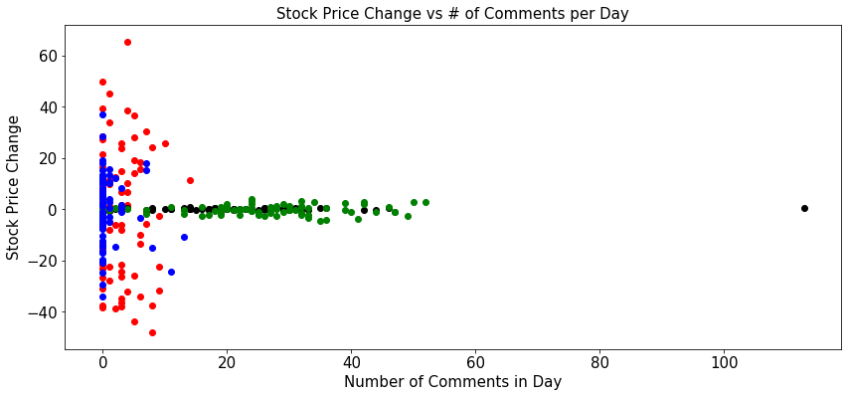
Plotting Eda phase 2
The graph below uses a Scatter Plot to see if there is any correlation between the change in price of a stock on a day, and the number of posts/comments that occurred in a particular day.

Slide 13
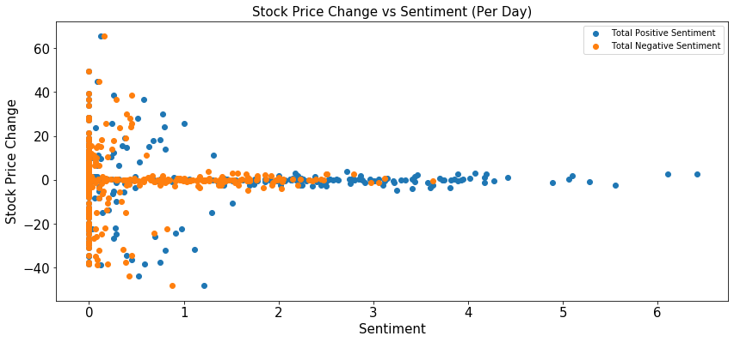
Plotting Eda phase 2
The Scatter Plot below searches for a correlation between movement of the stocks price on a given day, and the sentiment of the posts and comments on the same day. The plot though show’s no clear correlation. Hopefully the more complex ML analysis with more variables will show a correlation!

Slide 14
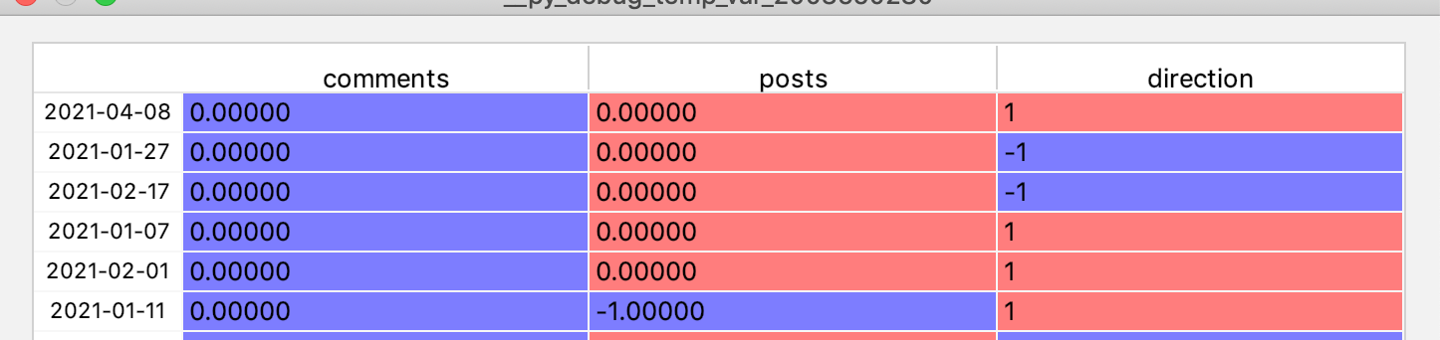
Building a DataFrame for ML
For each date we performed sentiment analysis on each post and comment
Using majority voting we determined the sentiment each day for posts and comments (our features)
Using the Open/Close price we determined the direction (our variable we will predict)

Slide 15
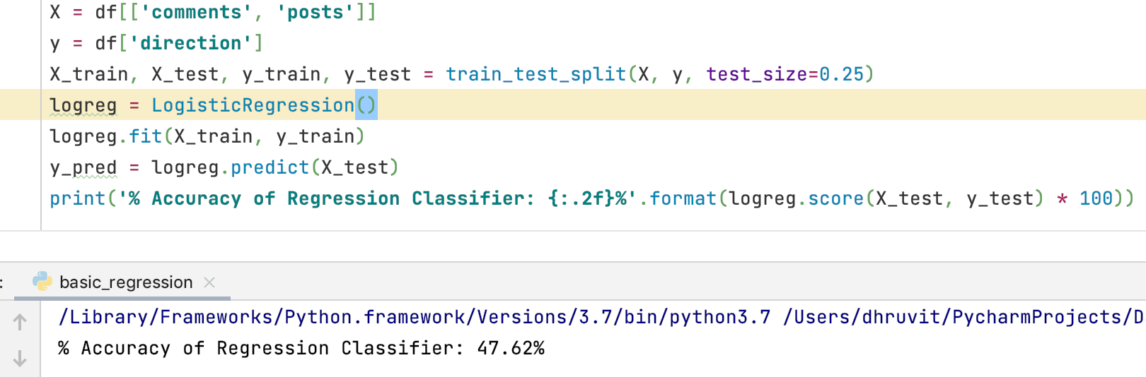
Logistic Regression Trial Analysis
As an initial strategy we used a simple regression classification method to determine if we are in the correct track.
Using sklearn package we created a Logistic Regression model

Slide 16
This Coming Week: June 4th-June 11th
Expand the number of companies and the time frame, to get more records.
Expand to using the Academic Research API for Twitter
Separating and Putting all Posts and Comments in a list of lists
Changing our Sentiment Feature to show Pos., Neg., or Neut. for each day.
Performing a Logistic Regression Trial Analysis with this new format
ReadMe re-organization and cleaning based Logistic Regression
Summer Semester
LSTM, SVM, and other more complex ML to find insightful patterns in our data!

